Slide 1

Housekeeping
Module 16 – Group Facilitation
Please mute yourself if you are not speaking.
Feel free to include your pronouns in your Zoom Name.
Use Zoom reaction tools, chat box, hands up, etc.
Be prepared to have video on at all times; as such, please be appropriately dressed and limit distractions.
Contribute to the conversations out loud and in the chat box.
If someone has already shared what you were going to say, lower your hand and put “agree” in the chat.
Notes:
COORDINATOR
Read out Housekeeping slide.

Slide 2
Expectations
Module 16 – Group Facilitation
Arrive on time.
Help us create a confidential, non-judgmental space (no screenshots or recordings).
Please keep your phones on silent.
Avoid cross-talk and side-talk.
Learn from each person’s perspective.
Language – please bring new language to us as we recognize that language is ever-changing.
Have fun!
From the group:
[ADD PARTICIPANT ADDITIONS, IF ANY]
Notes:
COORDINATOR
Read out Expectations slide.

Slide 3
Group Facilitation
Module 16
Notes:
Trainer Manual
Module 16: Group Facilitation © 2023 PeerWorks
This training program is designed to be accessible to all trainers, and ensure that all participants receive the same quality of education regardless of specific trainers’ background and experience.
This manual is a living document and should be understood as a set of guidelines, not as a fixed script. Feel free to adapt the language to your style of presentation. We also recognize that language is always changing; please update terminology when necessary. The synchronous sessions should be dynamic, engaging experiences.
TRAINER
Welcomes everyone and states the topic of today’s module.

Slide 4
Land Acknowledgement
Module 16 – Group Facilitation
[ADD TRAINER’S LAND ACKNOWLEDGEMENT HERE]
Notes:
TRAINER’S LAND ACKNOWLEDGEMENT

Slide 5
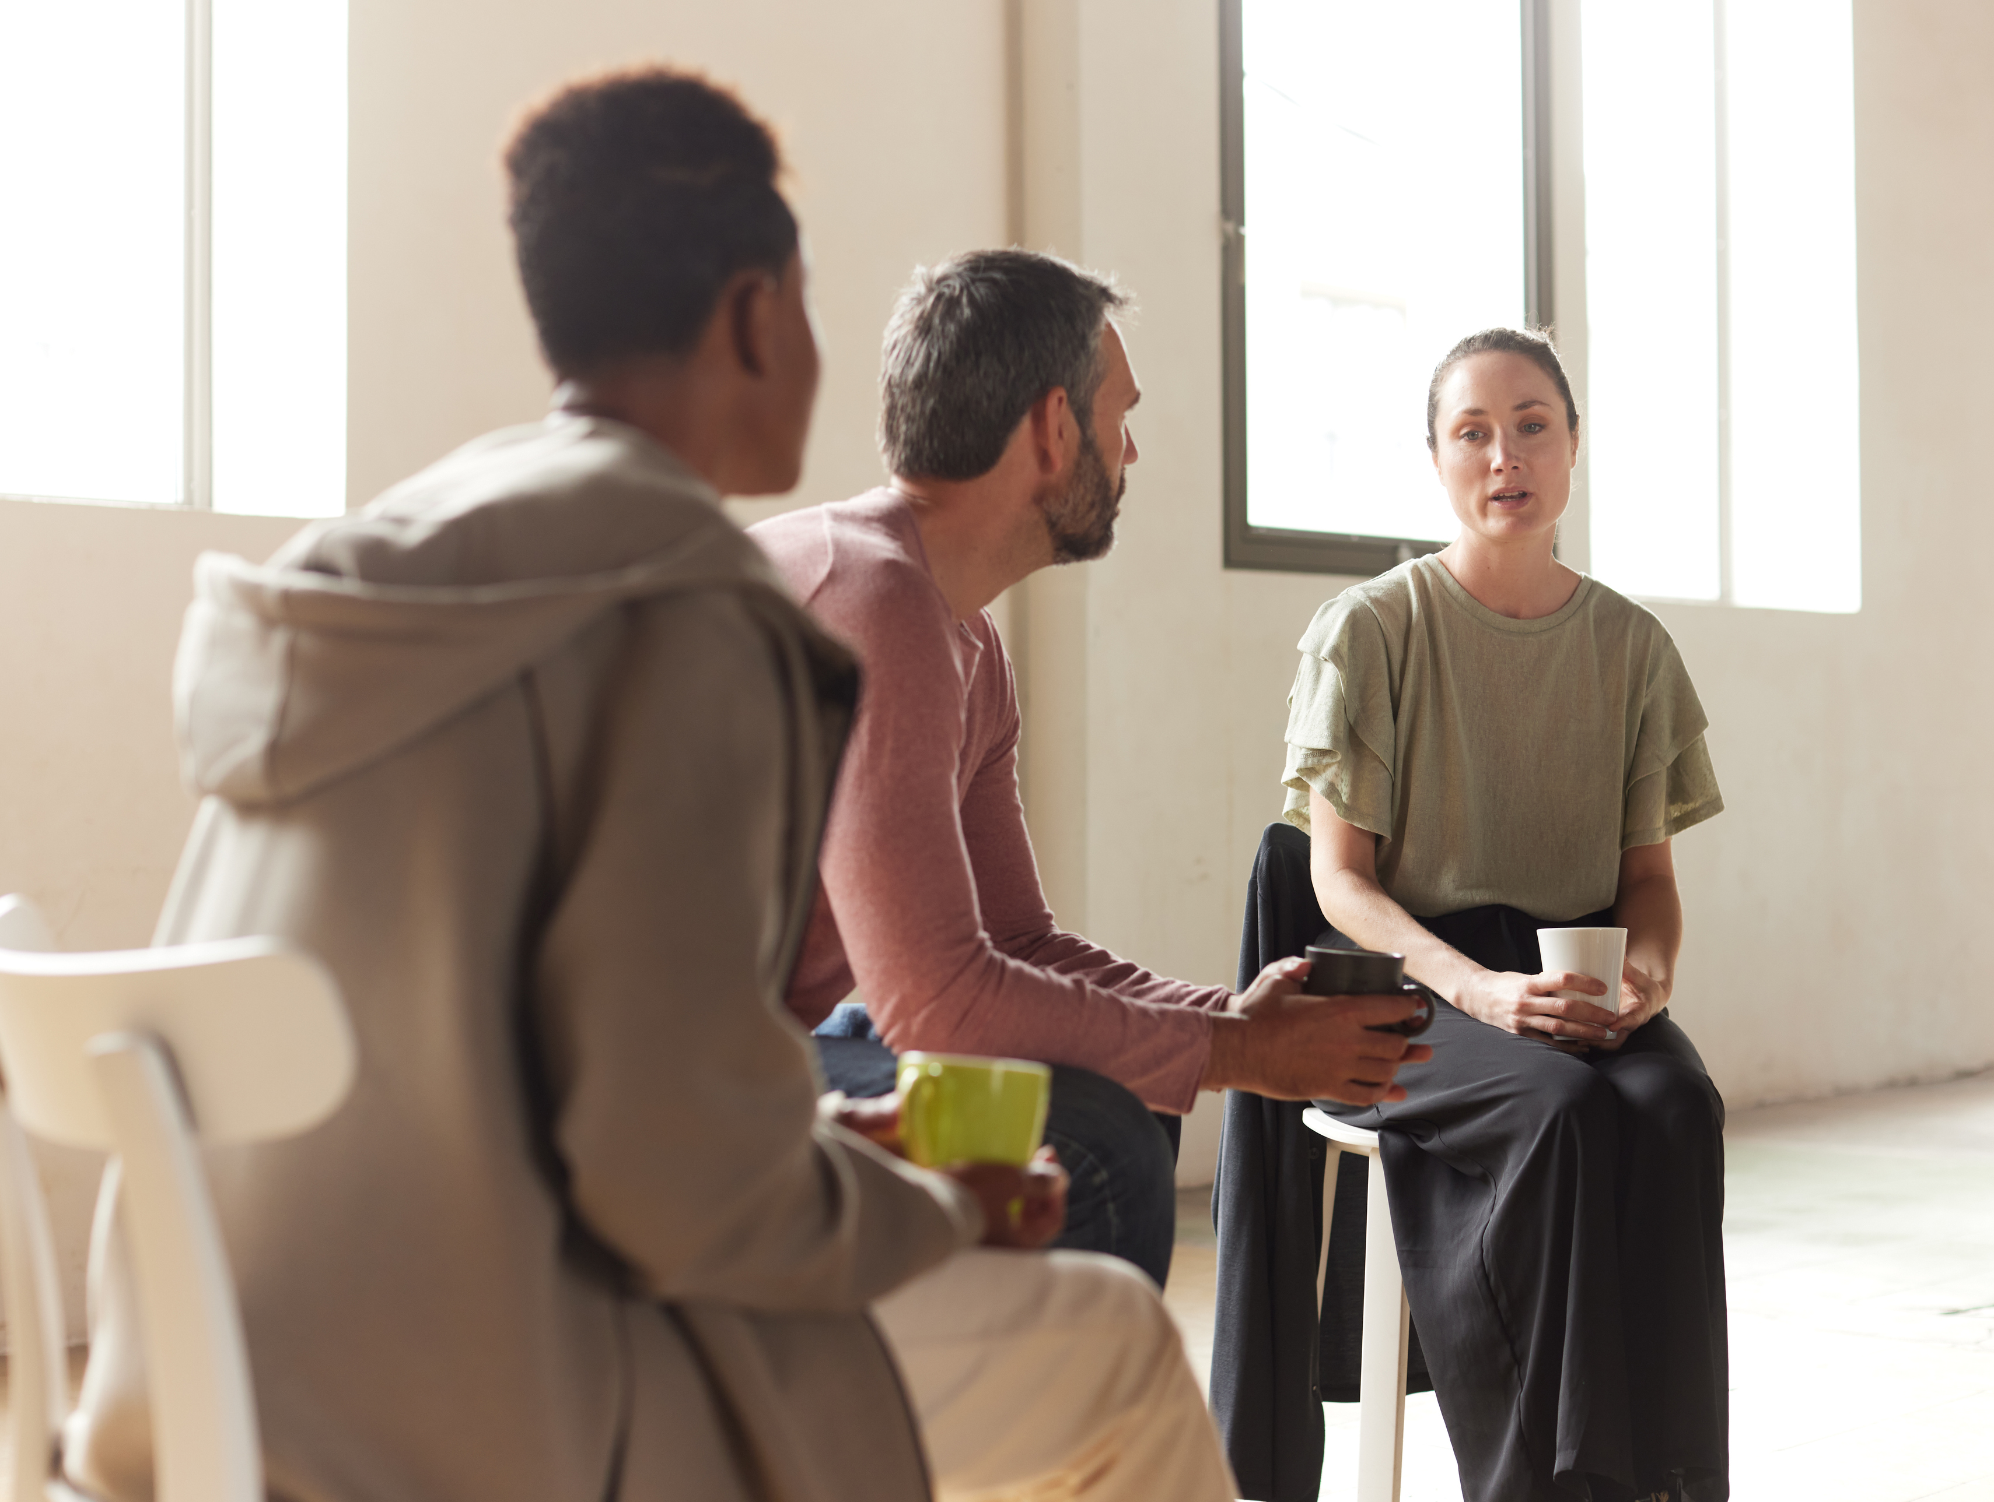
Icebreaker Activity
Module 16 – Group Facilitation
What is your name?
Describe a memorable group experience you’ve had.
Notes:
TRAINER
What is your name? Describe a memorable group experience you’ve had.
As the trainers, feel free to go first. Keep it brief and thank people for sharing.

Slide 6
Module Overview
Module 16 – Group Facilitation
In Module 16, we will discuss group facilitation. Peer Support relationships come in all different forms, including one-on-one, groups, in-person and online.
Group sessions require different skills and sets of knowledge than one-on-one.
Notes:
TRAINER
Read the Module Overview and Learning Objectives out loud or invite a participant to read it out loud.

Slide 7
Learning Objectives
Module 16 – Group Facilitation
Through the successful completion of Module 16, you will have the skills and knowledge to:
Facilitate a Peer Support group.
Work with Peer Support groups online and face-to-face.
Notes:
TRAINER
Read the Module Overview and Learning Objectives out loud or invite a participant to read it out loud.

Slide 8
Creating the Peer Support Environment
Module 16 – Group Facilitation
Throughout this series of modules, we have been meeting in a group setting to discuss Peer Support and improve our knowledge and skills related to Peer Support.
What did we do in week one to create an environment receptive to learning about Peer Support?
What do we do every week to maintain this environment?
Notes:
TRAINER
Read out the slide or ask the group the questions.
How did their experience with the online group change since the first meeting?

Slide 9
Creating Shared Expectations
Module 16 – Group Facilitation
These are the expectations we created at the beginning of Module 1. What would you add or change for a Peer Support Group?
Arrive on time.
Help us create a confidential, non-judgmental space (no screenshots or recordings).
Please keep your phones on silent.
Avoid cross-talk and side-talk.
Learn from each person’s perspective.
Language - please bring new language to us as we recognize that language is ever-changing.
Notes:
TRAINER
“These are the expectations we created at the beginning of Module 1. What would you add or change for a Peer Support Group?”

Slide 10
Confidentiality
Module 16 – Group Facilitation
While we can encourage confidentiality in the Peer Group setting, we unfortunately cannot guarantee it for our Peers. Though we might not repeat anything said in the group, we cannot promise the same to other group members.
For online group sessions, this can be even harder as some people do not have complete privacy in their home.
Though we ask group members not to record any aspect of group meetings, and we can turn off recording capabilities, this cannot be fully enforced.
For those reasons, some groups allow group members to turn their cameras off and/or use a pseudonym when they are sharing.
Create a password for the group invitation so that uninvited people cannot attend the meeting.
Notes:
TRAINER
Read out the slide or ask someone to read it. What other challenges can emerge in the online group? Has anyone had any experience with online Peer Support?

Slide 11
Confidentiality Skills Practice
Module 16 – Group Facilitation
Your peer is interested in attending an online Peer Support group but has concerns about the online environment. They have heard about “ZoomBombing” and are worried that group members do not take confidentiality as seriously in an online setting.
Practice what you would say to a Peer who brought up these concerns. Speak as though you are speaking directly to your Peer.
Each person in the group takes turns, then compare your different approaches.
What were the strengths of each group member?
Is there anything that wasn’t brought up?
Notes:
COORDINATOR
This is a skills practice activity to be done in small groups. It can be 2-3 people, depending on the amount of people in the group. If you have a group of three people, the third person can be the observer who offers an outside perspective, as well as the timekeeper.
After the activity, bring everyone back as a group and discuss approaches.
You should be halfway through your allotted time now.

Slide 12
Peer Support Groups
Module 16 – Group Facilitation
Even though we aren’t working one-on-one, we are still in the role of a Peer, not a group “leader” or “instructor.”
In a group, there will be many different personality types and communication styles. This can make it harder to match everyone’s method of communication. Be mindful of everyone in the room, even if they are not talking. Try to match their communication style when speaking to them.
Pay attention to your tone and voice. Is your tone encouraging? Enthusiastic? Warm? Check-in on yourself to ensure you convey your care and appreciation for others.
Remind people about the other options that are available to them, including warm lines.
Greet people as they arrive and open the meeting by engaging with the group through questions and comments.
Notes:
TRAINER
Read out the slide or invite someone to read it out.

Slide 13
Things You Can Provide as a Facilitator
Module 16 – Group Facilitation
Acknowledge what the person has shared!
Respond with affirmations that encourage them.
Summarize or clarify what someone has said.
Use eye contact and body language that reflects non-judgemental active listening.
Convey positive facial expressions, including nodding and smiling.
Notes:
TRAINER
NOTE: slide is animated. All 5 bullet points come up on the slide at the same time.
Ask the group what they can provide as a group facilitator. When you press the space bar the examples will pop up. If people are having trouble coming up with examples then you can click through to the examples, but you might find that the group is talkative enough without them.
Refer back to Tyrone’s Guidelines. How has he leveraged his position as facilitator to ensure the groups run smoothly?

Slide 14
Conflict Resolution
Module 16 – Group Facilitation
The best way to approach conflicts is to try and avoid them before they happen. This is why we recommend collaboratively creating group guidelines and expectations, as well as paying attention to the body language and shares of all group members. Remind everyone that all experiences are welcome and equally valid.
When a conflict does arise, approach it head-on so that it can be resolved immediately and does not become worse.
Focus on what the purpose of the group is and use affirmative language: “Please focus discussion on the topic at hand” vs. “We don’t talk about those topics here.”
Notes:
TRAINER
“The next two slides are on conflict resolution in a group setting. While we have discussed conflict resolution before, it can be different in a group setting.
Diversity and difference of opinions are great and can lead to discussions that are beneficial for everyone involved in the group. However, sometimes conflicts can arise within Peer Support Groups.”

Slide 15
Conflict Resolution
Module 16 – Group Facilitation
Refer back to the collaboratively created guidelines.
Use “I” sentences and encourage other group members to do the same: “I feel frustrated and not valued when my share is interrupted” vs “You interrupted my share and made me feel bad.”
Try to engage all group members and suggest multiple options to move forward. During a conflict resolution you can even ask “Does everyone feel as though their voice has been heard?”
If a resolution can’t be quickly reached, feel free to take a break and give people time away to process.
Notes:
TRAINER
“The next two slides are on conflict resolution in a group setting. While we have discussed conflict resolution before, it can be different in a group setting.
Diversity and difference of opinions are great and can lead to discussions that are beneficial for everyone involved in the group. However, sometimes conflicts can arise within Peer Support Groups.”

Slide 16
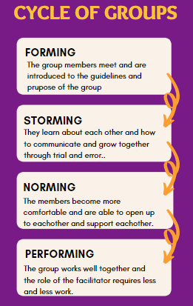
Notes:
TRAINER
“This diagram demonstrates the natural cycle that groups tend to go through.”
Go through the diagram with the group.

Slide 17
Scenario Group Discussion
Module 16 – Group Facilitation
You are a first-time facilitator leading a new Peer Support group. Tran is sharing with the group and Dave is nodding along to Tran’s share and talking to himself. Tran turns to Dave whenever she hears him talk and then continues on with her share, however, she does seem to be getting flustered by the interruptions.
After several of these interruptions, Dave loudly interrupts Tran to say “I totally get where you’re coming from, a similar thing happened to me...” and starts sharing his own experience.
As the group facilitator, what do you do?
How do you ensure everyone feels heard and respected in the Peer Support Group?
Notes:
TRAINER
Go through the scenario as a group.

Slide 18
Online Peer Support
Module 16 – Group Facilitation
Some people might be attending the meeting with audio only or might be visually impaired. It can help to have everyone introduce themselves at the beginning of the meeting/their share and refer to people by name throughout the meeting.
If someone with audio only is sharing, acknowledge their share verbally and let them know if others are responding nonverbally, such as “when you were sharing, I saw a lot of heads nodding in the room and Ahmet and Claire responded with heart emojis.”
Similarly, some people might have difficulty hearing everything. Many platforms have closed captioning, but some of them have to be individually turned on. Let everyone know about these options at the start of the session.
Notes:
TRAINER
These two slides are about online Peer Support and how to ensure that it runs smoothly. By now, the group is very familiar with online groups and they can share their experience as well.

Slide 19
Familiarity with Online Software
Module 16 – Group Facilitation
Make sure to practice with your software before the first session.
It can help to have a co-facilitator to share slides/monitor the chat.
Start the session 15 minutes early and invite group members to show up at that time to try out the software features.
Invite everyone to show up 5-10 minutes early if they would like the time to chat informally before the group begins. This can be a great warmup to the discussion.
In order to discourage side-chats and maintain everyone’s focus, you can disable one-on-one messages between participants. They will still be able to message you if they have questions, or message everyone as a group.
You can use private messages to reach out to someone if they look overwhelmed or unexpectedly disappear from view/turn their camera off.
Notes:
TRAINER
These two slides are about online Peer Support and how to ensure that it runs smoothly. By now, the group is very familiar with online groups and they can share their experience as well.

Slide 20
Face-to-face vs Online
Module 16 – Group Facilitation
Sometimes we find ourselves exaggerating our voice or actions online in order to come across as engaging, because our natural cadence can come across as monotonous over video. Other people might find it more difficult to maintain focus online and find themselves taking notes in order to help them pay attention.
Are there any other adjustments you’ve found yourself making in our online sessions?
Notes:
TRAINER
Group discussion. This question has come up before when we talked about minimizing distractions as Peer Supporters, but by now people will have had more experience with the group format and can share what has helped them learn.

Slide 21
Resources
Module 16 – Group Facilitation
Centre for Innovation in Peer Support “Toolkit for Implementing Virtual Services”
Tyrone’s Guidelines from the Module 15 Homework
Notes:
COORDINATOR
Go through the resources.

Slide 22
For Next Time
Module 16 – Group Facilitation
Do you have any questions for the final module?
Feel free to send them to us in advance or bring them to the next session.
Notes:
COORDINATOR
Read out the homework.

Slide 23
Thank You
Notes:
TRAINER
Thank everyone for their time and ask if anyone has any final comments or questions that they want to bring forward.

